Slide 1
Sustainability Programme
2026–2028
MAIN OBJECTIVES
Berner Group

Slide 2
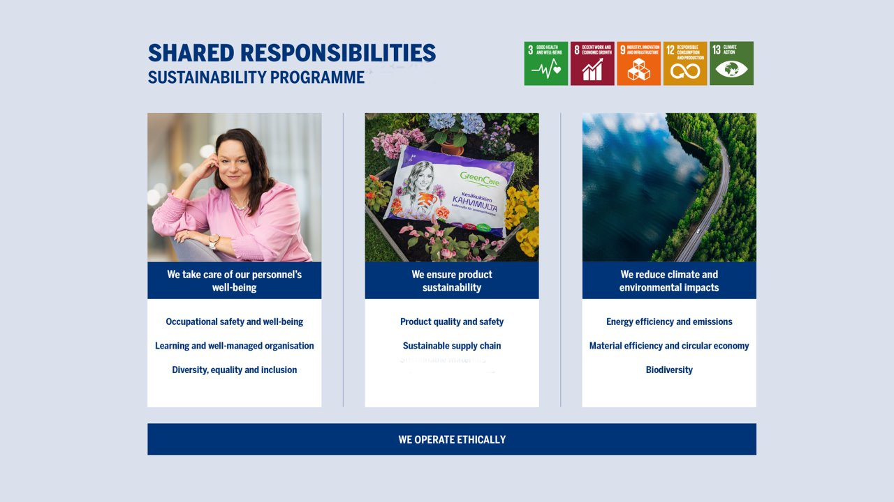

Slide 3

We operate ethically
100% of our staff in all operating countries undergoes online training on Code of Conduct biennially.

Slide 4

WE TAKE CARE OF OUR STAFF'S WELL-BEING
OCCUPATIONAL SAFETY AND WELL-BEING
Zero accidents and occupational disease cases.
We will achieve at least a score of 4/5 in the work well-being research.
LEARNING AND WELL-MANAGED ORGANIZATION
We exceed the annual and regional averages in leadership 360 assessments. Year 2026: Finland 81.5 and Europe 81.9.
DIVERSITY, EQUALITY AND INCLUSION
We achieve the goals of equality and inclusion in the workplace well-being study: Equal treatment and discussing issues without fear of repercussions, with a target of at least 4/5.

Slide 5

we ensure product sustainability
´SUSTAINABLE SUPPLY CHAIN
70 % of suppliers, measured in purchasing euros, have a valid EcoVadis sustainability assessment.
Suppliers in risk countries have a valdi social responsibility auditing or certification.
QUALITY AND SAFETY OF OWN PRODUCTS
Zero recall of own production products.
We will continue to conduct life cycle analyses and develop calculations to identify opportunities for reducing the environmental impacts of products.
We will increase the amount of renewable raw materials in the products.

Slide 6

WE REDUCE CLIMATE AND ENVIRONMENTAL IMPACTS
CLIMATE WORK AND ENERGY EFFICIENCY
We will reduce our emissions in our own operations and value chain in accordance with SBTi targets.
Main targets (2030 vs 2021): Scope 1 and 2: -42% Scope 3: -51.6%, intensity target Scope 3, FLAG: -30.3% Scope 3.11a (use of sold fossil fuels): -42%
We are improving energy efficiency in our own production.
BIODIVERSITY
We will reduce the impacts of our operations and value chain on biodiversity.

Slide 7

WE REDUCE CLIMATE AND ENVIRONMENTAL IMPACTS
CIRCULAR ECONOMY
We promote the circular economy in our own business.
We will increase the amount of internal recycling in production and direct waste streams more each year into raw materials for products.
MATERIAL EFFICIENCY AND CIRCULAR ECONOMY
We are optimizing water usage in our own production.
We reduce the environmental impact of significant waste streams.
Zero harmful disturbance emissions affecting the environment of our own production facilities.

